Slide 1
Local Method

Slide 2
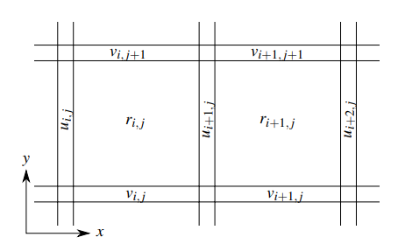
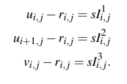
Local Method
Θ
H=sI¹_{ij}
Un-shadowed fraction
u_{ij}
H / s = I¹_{ij}
r_{ij}
r_{i,j} < min(u_{i,j} ,u_{i+1,j} , v_{i,j} , v_{i,j+1})
Make sure that only the walls are casting shadows
s.t
for –x and +x: |u_{i,j} − u_{i+1,j}| < s
Shadows are contained only in the pixels adjacent to the walls
for +y direction: v_{i,j} − v_{i,j+1} < s

Slide 3
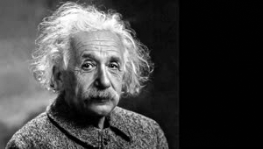
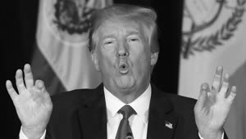
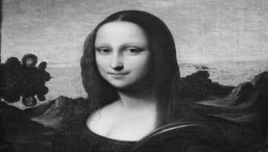
Implementation
Python
Reconstruction using the illuminated area:
Simulation using Unity3D

Slide 4
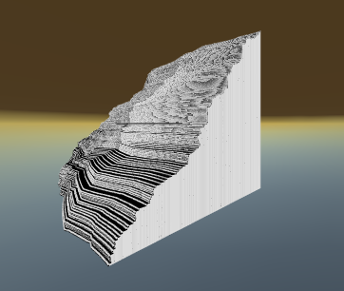
Simulation

Slide 5
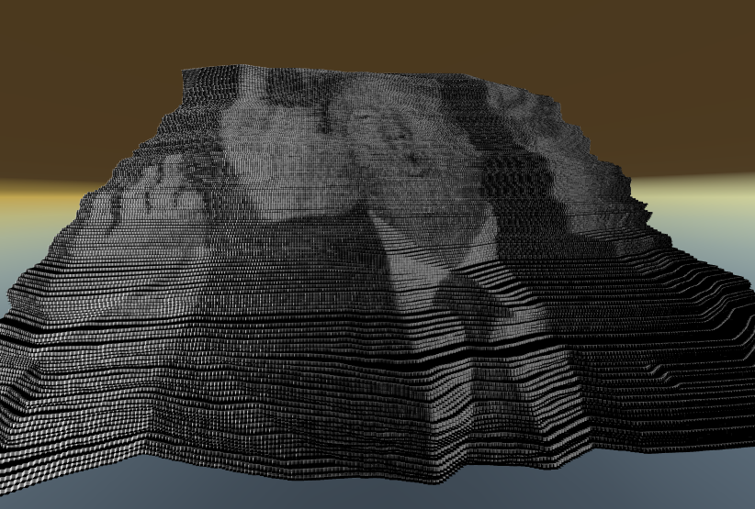
Simulation

Slide 6
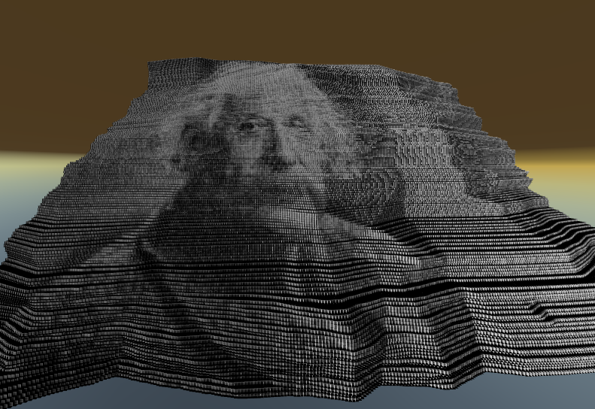
Simulation

Slide 7
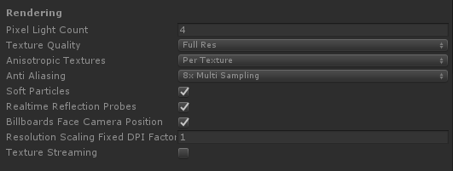
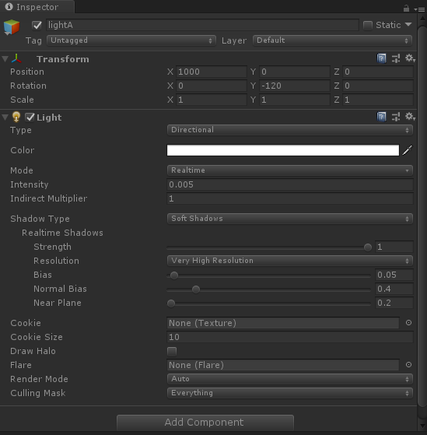
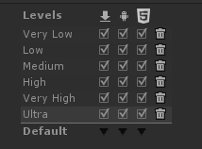
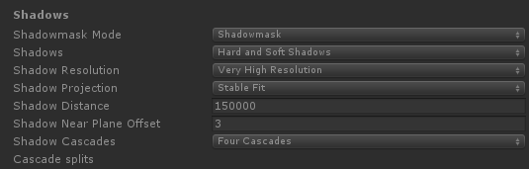
Simulation
Notes:
The Hard Shadows setting produces shadows with a sharp edge. Hard shadows are not particularly realistic compared to Soft Shadows but they involve less processing, and are acceptable for many purposes. Soft shadows also tend to reduce the “blocky” aliasing effect from the shadow map.
The Anti-aliasing effect gives graphics a smoother appearance. Aliasing is an effect where lines appear jagged or have a “staircase” appearance (as displayed in the left-hand image below). This can happen if the graphics output device does not have a high enough resolution to display a straight line.
The more cascades you use, the less your shadows will be affected by perspective aliasing

